Slide 1



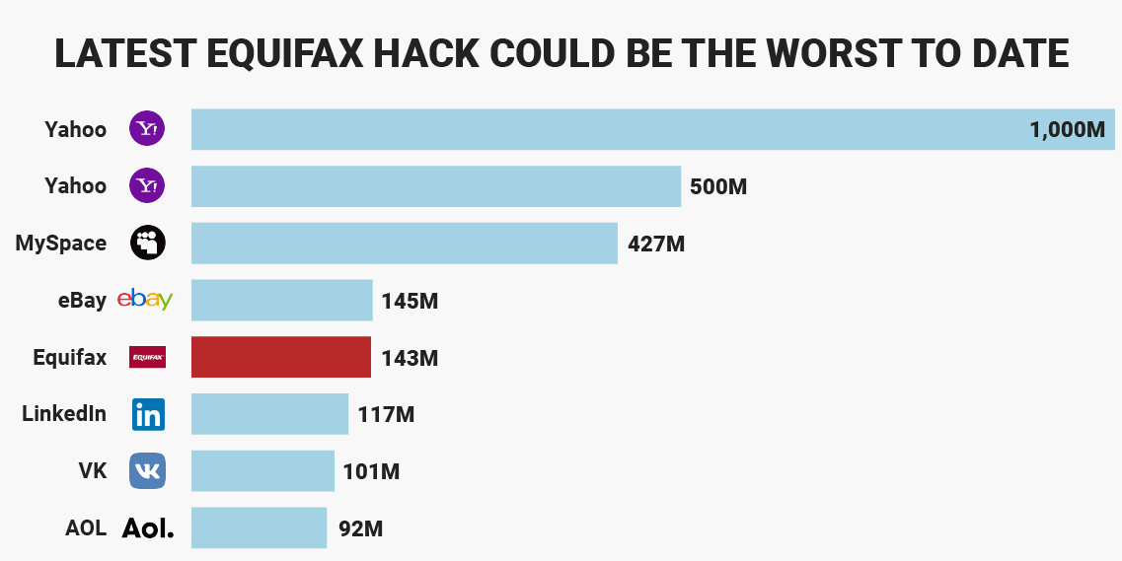
Making a Big Circle
Avery Peiffer
University of Pittsburgh First Year Engineering Program
Fall 2017
Bio
My Fit in Engineering
The Future of Engineering
I am originally from Harrisburg, the state capital of Pennsylvania. Being from Central Pennsylvania has been very influential on my decision to pursue engineering. The city and surrounding suburbs are not very big, so there is a significant agricultural presence in the community. Because of this, I was able to learn how to work with my hands in addition to my typical academic learning.
I have always enjoyed math, physics, and chemistry and am generally strong in those subjects. From an early point in my high school career, I figured that engineering would be the best way to apply these subjects.
Outside of engineering, I have recently taken an interest to philosophy. I am planning on pursuing a minor in the subject while at Pitt, but I would ideally also like to find a way to involve philosophy in my professional work as an engineer.
There is definitely a chance that I do not ultimately pursue engineering at the University of Pittsburgh. However, at this point, I am confident that engineering is right for me. Within the Swanson School of Engineering, I will most likely pursue computer engineering.
I find the disciplines of electrical engineering and computer science to both be very interesting. I have worked on projects for various extracurricular activities that require both knowledge in the programming of the specific software as well as the interactions between various pieces of hardware. Computer engineering is a representation of the combination and mutual interaction of both of these fields.
I prefer computer engineering to either electrical engineering or computer science because it is so much more versatile than either field. In computer engineering, I would have opportunities to work in positions related to both software and hardware, thus not requiring me to commit to either side of the field.
In my opinion, engineering is at a unique crossroads at this time. It can be argued that two opposite processes are occurring in parallel in contemporary society: the rapid progress in technological innovation and a decrease in faith in the validity of scientific reasoning. Engineering has a vital role in its interactions with society in reconciling this conflicting.
I believe that engineering must assume a more significant role in everyday interactions with the general public. Too often it feels as if people who deny scientific thinking do so because it seems foreign and inaccessible. This is true to an extent, as those conducting cutting-edge research in physics, chemistry, biology, etc., are doing so possessing a base of knowledge that is much beyond what is required to function in society.
Engineers occupy a unique role in that they cater to the exact and immediate needs of society. It would not be difficult to use engineering to educate the public, as the concepts engineers work with are much more relevant to the everyday lives of everyone in society.
Engineering, Society, and Me
For my Writing Assignment #3, I researched the state of the field of data security in the context of the recent breach at Equifax, where the personal data of 143 million American adults was compromised. I looked at the viability of current options for data security as well as possible future options with increasing interest in quantum computing.
This problem is obviously significant to all of society, but I find personal significance in its relation to the field of computer engineering. This specific problem concerns software more than hardware, but the problem-solving skills of any engineer are still highly applicable towards its resolution.
In my engineering career, I hope to work on problems with a scope such as that of data security. Though I can’t solve the entirety of the problem by myself, my goal for my professional career is to make a positive contribution towards the progress of solving such a problem.
Harrisburg State Capitol Complex, in front of Susquehanna River
Impact of Equifax breach as well as significance of problem of data security
Contact
Avery Peiffer
University of Pittsburgh: Swanson School of Engineering
Email: aep65@pitt.edu
Website: www.pitt.edu/aep65

